Slide 1
Algoritma Pemograman dan Struktur Data
Pertemuan 4
By Neny Rosmawarni S.Kom, M.Kom

Slide 2
C++ Programming: From Problem Analysis to Program Design, Third Edition
Chapter 5: Control Structures II (Repetition)

Slide 3
Objectives
In this chapter you will:
Learn about repetition (looping) control structures
Explore how to construct and use count-controlled, sentinel-controlled, flag-controlled, and EOF-controlled repetition structures
Examine break and continue statements
Discover how to form and use nested control structures

Slide 4
Why Is Repetition Needed?
Repetition allows you to efficiently use variables
Can input, add, and average multiple numbers using a limited number of variables
For example, to add five numbers:
Declare a variable for each number, input the numbers and add the variables together
Create a loop that reads a number into a variable and adds it to a variable that contains the sum of the numbers

Slide 5
The while Loop
The general form of the while statement is:
while (expression)
statement
while is a reserved word
Statement can be simple or compound
Expression acts as a decision maker and is usually a logical expression
Statement is called the body of the loop
The parentheses are part of the syntax

Slide 6
The while Loop (continued)
Expression provides an entry condition
Statement executes if the expression initially evaluates to true
Loop condition is then reevaluated
Statement continues to execute until the expression is no longer true

Slide 7
The while Loop (continued)
Infinite loop: continues to execute endlessly
Can be avoided by including statements in the loop body that assure exit condition will eventually be false

Slide 8
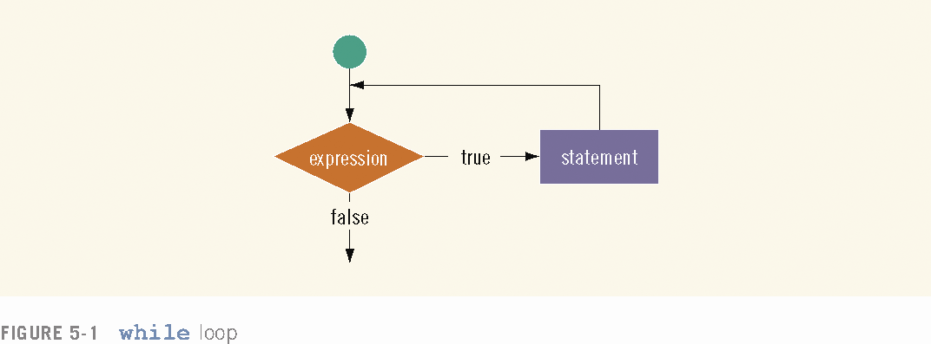

Slide 9
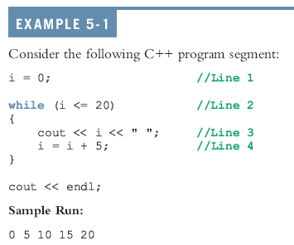

Slide 10
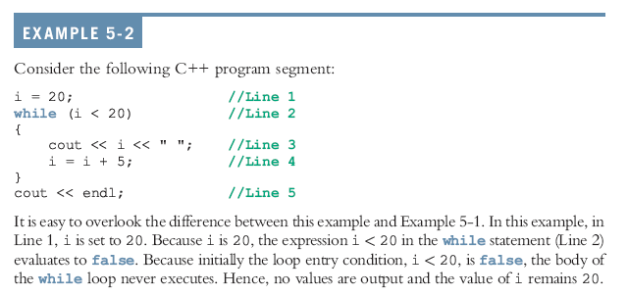

Slide 11
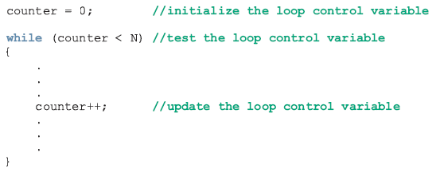
Counter-Controlled while Loops
If you know exactly how many pieces of data need to be read, the while loop becomes a counter-controlled loop

Slide 12
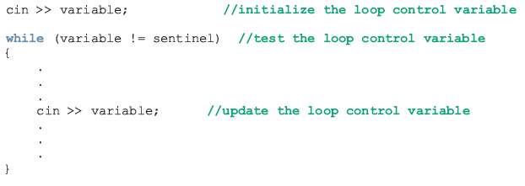
Sentinel-Controlled while Loops
Sentinel variable is tested in the condition and loop ends when sentinel is encountered

Slide 13
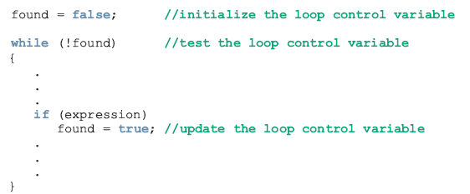
Flag-Controlled while Loops
A flag-controlled while loop uses a bool variable to control the loop
The flag-controlled while loop takes the form:

Slide 14
The for Loop
The general form of the for statement is:
for (initial statement; loop condition;
update statement)
statement
The initial statement, loop condition, and update statement are called for loop control statements

Slide 15
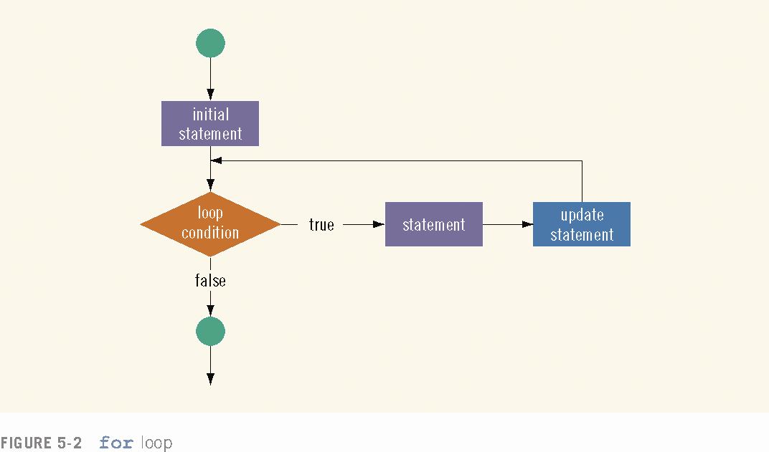

Slide 16
The for loop executes as follows:
1. The initial statement executes.
2. The loop condition is evaluated. If the loop condition evaluates to true
i. Execute the for loop statement.
ii. Execute the update statement (the third expression in the parentheses).
Repeat Step 2 until the loop condition evaluates to false.
The initial statement usually initializes a variable (called the for loop control, or for indexed, variable).
In C++, for is a reserved word.

Slide 19
The for Loop (comments)
The following are some comments on for loops:
If the loop condition is initially false, the loop body does not execute.
The update expression, when executed, changes the value of the loop control variable (initialized by the initial expression), which eventually sets the value of the loop condition to false. The for loop body executes indefinitely if the loop condition is always true.
C++ allows you to use fractional values for loop control variables of the double type (or any real data type). Because different computers can give these loop control variables different results, you should avoid using such variables.

Slide 20
The for Loop (comments)
A semicolon at the end of the for statement (just before the body of the loop) is a semantic error. In this case, the action of the for loop is empty.
In the for statement, if the loop condition is omitted, it is assumed to be true.
In a for statement, you can omit all three statements—initial statement, loop condition, and update statement. The following is a legal for loop:
for (;;)
cout << "Hello" << endl;

Slide 21
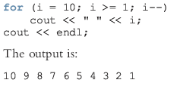

Slide 22
The do…while Loop
The general form of a do...while statement is:
do
statement
while (expression);
The statement executes first, and then the expression is evaluated
If the expression evaluates to true, the statement executes again
As long as the expression in a do...while statement is true, the statement executes

Slide 23
The do…while Loop (continued)
To avoid an infinite loop, the loop body must contain a statement that makes the expression false
The statement can be simple or compound
If compound, it must be in braces
do...while loop has an exit condition and always iterates at least once (unlike for and while)

Slide 24
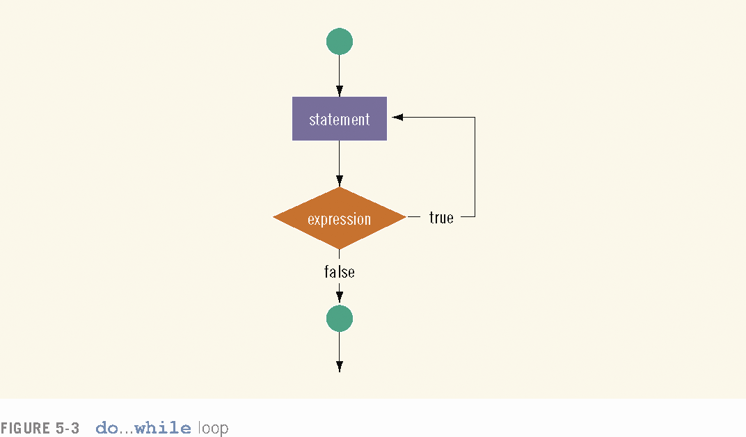

Slide 25
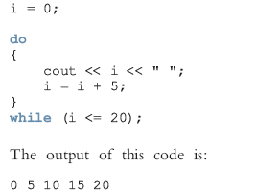

Slide 26
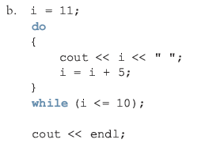
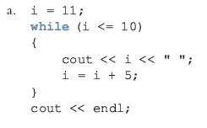

Slide 27
break & continue Statements
break and continue alter the flow of control
When the break statement executes in a repetition structure, it immediately exits
The break statement, in a switch structure, provides an immediate exit
The break statement can be used in while, for, and do...while loops

Slide 28
break & continue Statements (continued)
The break statement is used for two purposes:
To exit early from a loop
To skip the remainder of the switch structure
After the break statement executes, the program continues with the first statement after the structure
The use of a break statement in a loop can eliminate the use of certain (flag) variables

Slide 29
break & continue Statements (continued)
continue is used in while, for, and do…while structures
When executed in a loop
It skips remaining statements and proceeds with the next iteration of the loop

Slide 30
break & continue Statements (continued)
In a while and do…while structure
Expression (loop-continue test) is evaluated immediately after the continue statement
In a for structure, the update statement is executed after the continue statement
Then the loop condition executes

Slide 31
Nested Control Structures
Suppose we want to create the following pattern
*
**
***
****
*****
In the first line, we want to print one star, in the second line two stars and so on

Slide 32
Nested Control Structures (continued)
Since five lines are to be printed, we start with the following for statement
for (i = 1; i <= 5 ; i++)
The value of i in the first iteration is 1, in the second iteration it is 2, and so on
Can use the value of i as limit condition in another for loop nested within this loop to control the number of starts in a line

Slide 33
Nested Control Structures (continued)
The syntax is:
for (i = 1; i <= 5 ; i++)
{
for (j = 1; j <= i; j++)
cout << "*";
cout << endl;
}

Slide 34
Nested Control Structures (continued)
What pattern does the code produce if we replace the first for statement with the following?
for (i = 5; i >= 1; i--)
Answer:
*****
****
***
**
*

Slide 35
Summary
C++ has three looping (repetition) structures: while, for, and do…while
while, for, and do are reserved words
while and for loops are called pre-test loops
do...while loop is called a post-test loop
while and for may not execute at all, but do...while always executes at least once

Slide 36
Summary (continued)
while: expression is the decision maker, and the statement is the body of the loop
In a counter-controlled while loop,
Initialize counter before loop
Body must contain a statement that changes the value of the counter variable
A sentinel-controlled while loop uses a sentinel to control the while loop

Slide 37
Thank you

