Slide 1
Data Compression
Pertemuan 4
By Neny Rosmawarni S.Kom, M.Kom

Slide 2
Outline
1. Shannon Fano Coding
  o Prinsip dasar Shannon Fano Coding
  o Algoritma Shannon Fano Coding
  o Average length dan redundancy
2. Huffman Coding
o Prinsip dasar Huffman Coding
  o Algoritma Huffman Coding
  o Average length dan redundancy
  o Minimum Variance Huffman Coding
  o Extended Huffman Coding
3. Golomb & Tunstall code
  o Integer encoding
  o Unary code
  o Algoritma Golomb CodingAlgoritma Tunstall Code
4. Arithmatic Coding
  o Prinsip dasar Arithmetic Coding
  o Algoritma Arithmetic Coding
  o Arithmetic Decoding
  o Binary Code
  o Binary Code untuk Arithmetic Coding

Slide 3
Algorithms in the Real World
Data Compression I
  Introduction
  Information Theory
  Probability Coding

Slide 4
Compression in the Real World
Generic File Compression
files: gzip (LZ77), bzip (Burrows-Wheeler), BOA (PPM)
archivers: ARC (LZW), PKZip (LZW+)
file systems: NTFS
Communication
Fax: ITU-T Group 3 (run-length + Huffman)
Modems: V.42bis protocol (LZW) MNP5 (RL + Huffman)
Virtual Connections

Slide 5
Multimedia
Images: gif (LZW), jbig (context), jpeg-ls (residual),
jpeg (transform+RL+arithmetic)
TV: HDTV (mpeg-4)
Sound: mp3

Slide 6
Compression Outline
Introduction: Lossy vs. Lossless, Benchmarks, …
Information Theory: Entropy, etc.
Probability Coding: Huffman + Arithmetic Coding
Applications of Probability Coding: PPM + others
Lempel-Ziv Algorithms: LZ77, gzip, compress, ...
Other Lossless Algorithms: Burrows-Wheeler
Lossy algorithms for images: JPEG, fractals, ...
Lossy algorithms for sound?: MP3, ...

Slide 7
Encoding/Decoding
Will use “message” in generic sense to mean the data to be compressed
Input
Message
Encoder
Compressed
Message
Decoder
Output
Message
The encoder and decoder need to understand common compressed format.

Slide 8
Lossless vs. Lossy
Lossless: Input message = Output message
Lossy: Input message ≈ Output message
Lossy does not necessarily mean loss of quality. In fact the output could be “better” than the input.
  Drop random noise in images (dust on lens)
  Drop background in music
  Fix spelling errors in text. Put into better form.
Writing is the art of lossy text compression.

Slide 9
How much can we compress?
For lossless compression, assuming all input messages are valid, if even one string is compressed, some other must expand.

Slide 10
Model vs. Coder
To compress we need a bias on the probability of messages. The model determines this bias
Example models:
  Simple: Character counts, repeated strings
  Complex: Models of a human face
Encoder
Messages
Model
Probs.
Coder
Bits

Slide 11
Quality of Compression
Runtime vs. Compression vs. Generality
Several standard corpuses to compare algorithms
Calgary Corpus
2 books, 5 papers, 1 bibliography,
1 collection of news articles, 3 programs,
1 terminal session, 2 object files,
1 geophysical data, 1 bitmap bw image
The Archive Comparison Test maintains a comparison of just about all algorithms publicly available

Slide 12
Comparison of Algorithms

Slide 13
Information Theory
An interface between modeling and coding
Entropy
  A measure of information content
Conditional Entropy
  Information content based on a context
Entropy of the English Language
  How much information does each character in “typical” English text contain?

Slide 14
Entropy (Shannon 1948)
For a set of messages S with probability p(s), s ∈S, the self information of s is:
Measured in bits if the log is base 2.
The lower the probability, the higher the information
Entropy is the weighted average of self information.

Slide 15
Entropy Example

Slide 16
Conditional Entropy
The conditional probability p(s|c) is the probability of s in a context c. The conditional self information is
The conditional information can be either more or less than the unconditional information.
The conditional entropy is the average of the conditional self information a

Slide 17
Example of a Markov Chain
p(b|w)
p(w|w)
w
b
p(b|b)
p(w|b)

Slide 18
Entropy of the English Language
How can we measure the information per character?
  ASCII code = 7
  Entropy = 4.5 (based on character probabilities)
  Huffman codes (average) = 4.7
  Unix Compress = 3.5
  Gzip = 2.5
  BOA = 1.9 (current close to best text compressor)
Must be less than 1.9.

Slide 19
Shannon’s experiment
Asked humans to predict the next character given the whole previous text. He used these as conditional probabilities to estimate the entropy of the English Language.
The number of guesses required for right answer:
From the experiment he predicted
H(English) = .6-1.3

Slide 20
Coding
How do we use the probabilities to code messages?
Prefix codes and relationship to Entropy
Huffman codes
Arithmetic codes
Implicit probability codes

Slide 21
Assumptions
Communication (or file) broken up into pieces called messages.
Adjacent messages might be of a different types and come from a different probability distributions
We will consider two types of coding:
Discrete: each message is a fixed set of bits
  Huffman coding, Shannon-Fano coding
Blended: bits can be “shared” among messages
  Arithmetic coding

Slide 22
Uniquely Decodable Codes
A variable length code assigns a bit string (codeword) of variable length to every message value
e.g. a = 1, b = 01, c = 101, d = 011
What if you get the sequence of bits
1011 ?
Is it aba, ca, or, ad?
A uniquely decodable code is a variable length code in which bit strings can always be uniquely decomposed into its codewords.

Slide 23
Prefix Codes
A prefix code is a variable length code in which no codeword is a prefix of another word
e.g a = 0, b = 110, c = 111, d = 10
Can be viewed as a binary tree with message values at the leaves and 0 or 1s on the edges.
0
1
0
1
a
0
1
d
b
c

Slide 24
Some Prefix Codes for Integers
Many other fixed prefix codes:
Golomb, phased-binary, subexponential, ...

Slide 25
Average Length
For a code C with associated probabilities p(c) the average length is defined as
We say that a prefix code C is optimal if for all prefix codes C’, l_{a}(C) ≤ l_{a}(C’)

Slide 26
Relationship to Entropy
Theorem (lower bound): For any probability distribution p(S) with associated uniquely decodable code C,
Theorem (upper bound): For any probability distribution p(S) with associated optimal prefix code C,

Slide 27
Kraft McMillan Inequality
Theorem (Kraft-McMillan): For any uniquely decodable code C,
Also, for any set of lengths L such that
there is a prefix code C such that

Slide 28
Proof of the Upper Bound (Part 1)
Assign to each message a length
We then have
So by the Kraft-McMillan ineq. there is a prefix code with lengths l(s).

Slide 29
Proof of the Upper Bound (Part 2)
Now we can calculate the average length given l(s)
And we are done.

Slide 30
Another property of optimal codes
Theorem: If C is an optimal prefix code for the probabilities {p₁, …, p_{n}} then p_{i} < p_{j}
implies l(c_{i}) ≤ l(c_{j})
Proof: (by contradiction)
Assume l(c_{i}) > l(c_{j}). Consider switching codes c_{i} and c_{j}. If l_{a} is the average length of the original code, the length of the new code is
This is a contradiction since l_{a} is not optimal

Slide 31
Huffman Codes
Invented by Huffman as a class assignment in 1950.
Used in many, if not most compression algorithms
gzip, bzip, jpeg (as option), fax compression,…
Properties:
  Generates optimal prefix codes
  Cheap to generate codes
  Cheap to encode and decode
  l_{a}=H if probabilities are powers of 2

Slide 32
Huffman Codes
Huffman Algorithm
Start with a forest of trees each consisting of a single vertex corresponding to a message s and with weight p(s)
Repeat:
  Select two trees with minimum weight roots p₁ and p₂
  Join into single tree by adding root with weight p₁ + p₂

Slide 33
Example
p(a) = .1, p(b) = .2, p(c ) = .2, p(d) = .5
a(.1)
b(.2)
c(.2)
d(.5)
(.3)
(.5)
(1.0)
0
1
a(.1)
b(.2)
(.5)
d(.5)
(.3)
c(.2)
0
1
Step 1
(.3)
c(.2)
a(.1)
b(.2)
0
1
Step 2
a(.1)
b(.2)
Step 3
a=000, b=001, c=01, d=1

Slide 34
Encoding and Decoding
Encoding: Start at leaf of Huffman tree and follow path to the root. Reverse order of bits and send.
Decoding: Start at root of Huffman tree and take branch for each bit received. When at leaf can output message and return to root.
(1.0)
0
1
There are even faster methods that can process 8 or 32 bits at a time
(.5)
d(.5)
0
1
(.3)
c(.2)
0
1
a(.1)
b(.2)

Slide 35
Huffman codes are optimal
Theorem: The Huffman algorithm generates an optimal prefix code.

Slide 36
PROBLEM
Image require a lots of space as file & can be very large. They need to be exchange from various imaging system
There is a need to reduce both the amount of storage Space & transmission time.
This lead us to the area of image compression.

Slide 37
Introduction
It is an important concept in image processing.
Image & video takes a lot of time, space, bandwidth in processing , storing, & transmission.
So, image compression is very necessary.
Data & information are two different things. Data is raw & its processed form is information.
In data compression there is no compromise with information quality only data used to represent the data is reduced .

Slide 38
Types Of Data
Text data: Read & understood by humans.
Binary Data: Machine can interpret only.
Image data: Pixel data that contains the intensity and color information of image.
Graphics Data: Data in vector form.
Sound Data: Audio information.
Video Data: Video information.
Data compression is essential due to three reasons: Storage, Transmission, & Faster Computation.

Slide 39
Contd….
Compression Scheme:
Original Information
Transmission
Visual information
Sampling Quantize
Compression Algorithm
Decompression Algorithm
Storage

Slide 40
Contd….
Compression & decompression algorithm apply on both side.
Compressor & decompressor are known as coder & decoder.
Both of them collectively known as codec.
Codec may be hardware/software.
Encoder takes symbols from data, removes redundancies & sends data across channel.

Slide 41
ContD….
Decoder has two parts channel decoder & symbol decoder.
Source encoder
Channel encoder
F(x,y)
Transmission Link
Source Decoder
Channel Decoder

Slide 42
Compression Measure
Compression Algorithm is a mathematical transformation for mapping a measure of Ni data bits to a set of N2 data bits codes.
Only representation of message is changed so that it will be more compact than earlier one.
This type of substitution is called logical compression.
At image level, the transformation of input message to a compact representation of code is more complex and is called as physical compression.

Slide 43
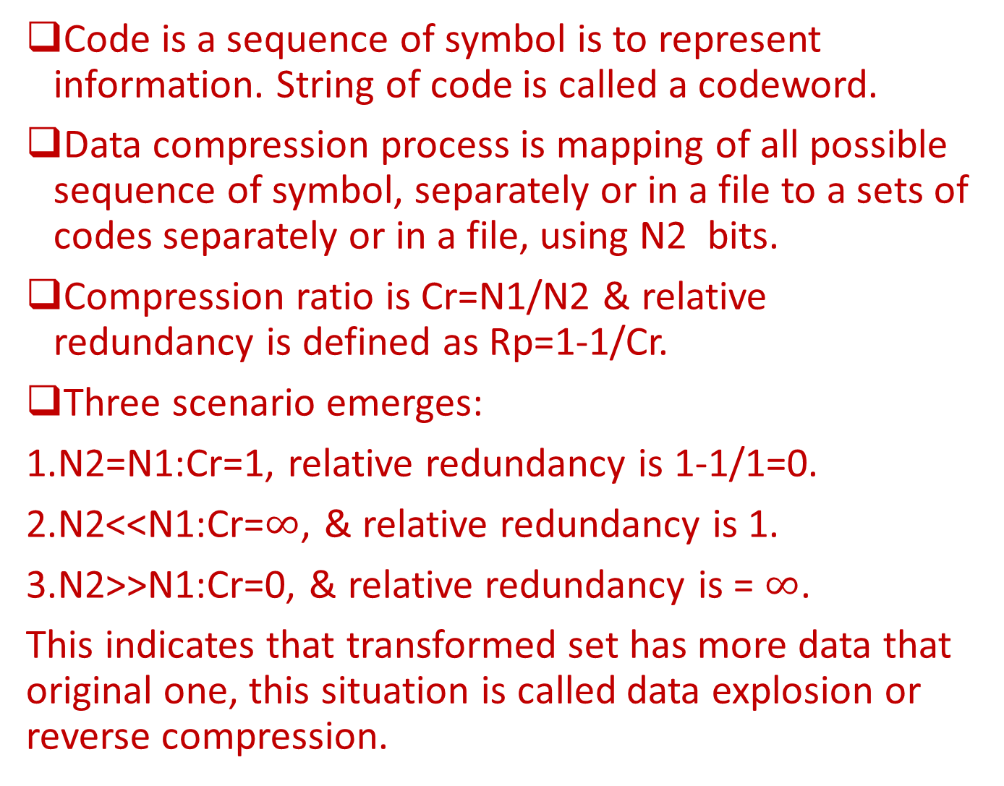
Contd….
Code is a sequence of symbol is to represent information. String of code is called a codeword.
Data compression process is mapping of all possible sequence of symbol, separately or in a file to a sets of codes separately or in a file, using N2 bits.
Compression ratio is Cr=N1/N2 & relative redundancy is defined as Rp=1-1/Cr.
Three scenario emerges:
1.N2=N1:Cr=1, relative redundancy is 1-1/1=0.
2.N2<<N1:Cr=$∞$, & relative redundancy is 1.
3.N2>>N1:Cr=0, & relative redundancy is = $∞$.
This indicates that transformed set has more data that original one, this situation is called data explosion or reverse compression.

Slide 44
Compression Ratio
Cr=Message file before compression/Code size After compression =N1/N2.
It is expressed as N1:N2.
It is common to use Cr of 4:1, 4 pixel of input image expressed as I pixel.

Slide 45
Saving Percentage
Saving percentage=1-{message size after compression /code file before compression}=1-(Ni/N2).

Slide 46
Bit Rate
Bit Rate=size of compressed file/total no. of pixel in the image=N1:N2.

Slide 47
Compression algorithm & its type
It is to reduce the source data to compressed form & decompress it to retain original data.
Compression algorithm would have an idea about the symbol to be coded.
Algorithm has two components:
1.Modeller: It is use to condition the image for compression using the knowledge of the data. It is present at both ends, & it is of two types Static & Dynamic.
Algorithm is of two types static & dynamic compression algorithm.

Slide 48
Contd….
2.Coder: Sender side coder is called encoder. Receiver side coder is called decoder. If model at both end is same then compression scheme is called asymmetric
Compression algorithm is of two type:
1.Lossless compression.
2.Lossy compression.

Slide 49
Contd….
Lossless compression is useful in preventing information.
Lossy compression algorithms compress data with a certain amount of error.
Another way of classifying compression algorithm are as follows:
1.Entropy coding.
2.Predictive coding.
3.Tronsform coding.
4.Layered coding.

Slide 50
Contd….
Lossless Compression
Losssy compression
Reversible process & no information loss.
Compression ratio is usually less.
Compression is independent of psychovisual system.
Require in domains where reliability is most important, e.g. medical data.
Non-reversible process & info. is lost.
Compression ratio is very high.
Compression is dependent of psychovisual process.
Useful in domain where losefull data is acceptable.

Slide 51
Entropy Coding
Logic behind that is if pixels are not uniformly distributed, then appropriate coding scheme can be selected that can encode the info. So that avg. no. of bits is less then the entropy.
Entropy specifies the min. no. of bits req. to encode information.
Coding is based on the entropy of source & possibility of occurrence of the symbol.
Examples are Huffman coding, Arithmetic coding, & Dictionary-based coding.

Slide 52
Predictive Coding
It is to remove the mutual dependency b/w the successive pixel & then perform coding.
Pixel: 400 405 420 425
Difference: 5 15 5
Difference is always lesser than original & requires fewer bits for representation.
This approach may not work effectively for rapidly changing data(30,4096,128,4096,12).

Slide 53
Transform coding
It is to exploit the information packing capability of transform.
Energy is packed in few component & only these are encoded & transmitted.
It removes redundant high frequency component to create compression
This removal causes information loss but it is exactable as it should be used in imaging & video compression.

Slide 54
Layered Coding
It is very useful in case of layered images.
Data structure like pyramids are useful to represent an image in this multiresolution form.
These images are segmented on the basis of foreground & background & based on the needs of application, encoding is performed.
It is also in form of selected frequency coefficients or bits of pixels of an image.

Slide 55
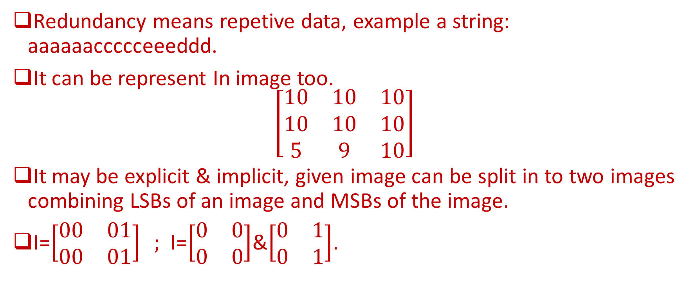
Redundancy
Redundancy means repetive data, example a string: aaaaaaccccceeeddd.
It can be represent In image too.
$$\left[\begin{matrix}10 & 10 & 10 \\ 10 & 10 & 10 \\ 5 & 9 & 10\end{matrix}\right]$$
It may be explicit & implicit, given image can be split in to two images combining LSBs of an image and MSBs of the image.
I=$\left[\begin{matrix}00 & 01 \\ 00 & 01\end{matrix}\right] ;$I=$\left[\begin{matrix}0 & 0 \\ 0 & 0\end{matrix}\right]$&$\left[\begin{matrix}0 & 1 \\ 0 & 1\end{matrix}\right]$.

Slide 56
Coding Redundancy.
Aims to measure information using the element of surprise.
Event occurring frequently have high probability &others having low .
Amount of uncertainty is called self information associated with event.
I(Si)=log2(1/Pi) or I(Si)=-log2(Pi).
Coding redundancy=Avg. bits used to code-Entropy.

Slide 57
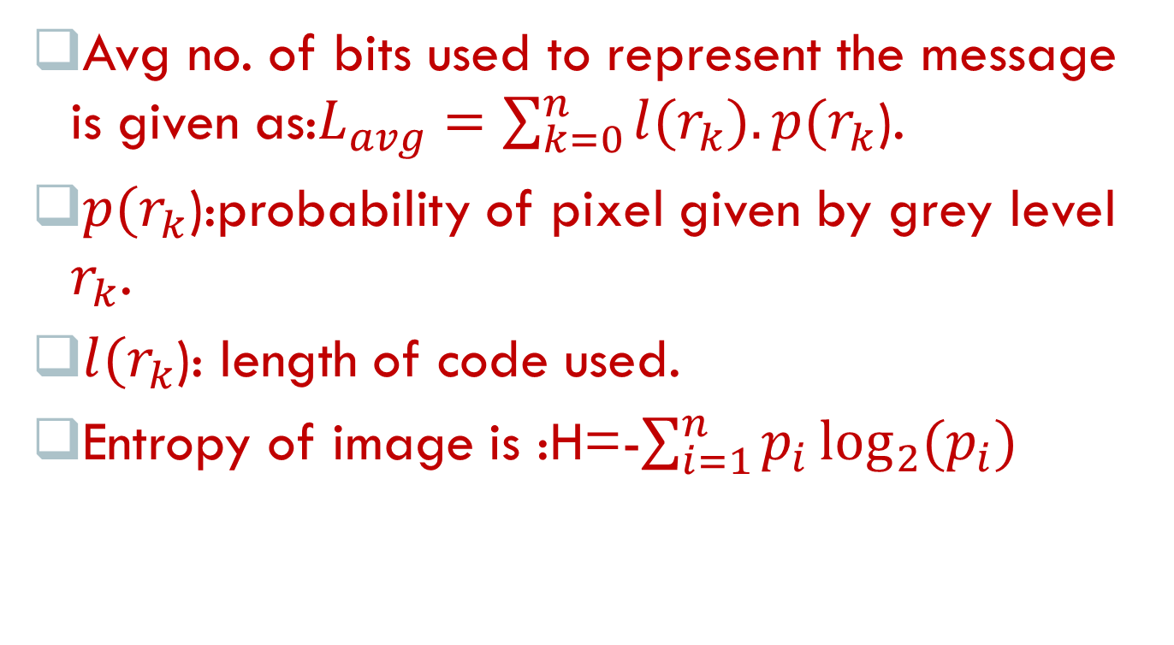
Contd….
Avg no. of bits used to represent the message is given as:$L_{avg}=\sum_{k=0}^{n}{l(r_{k}}).p(r_{k}$).
$p(r_{k}$):probability of pixel given by grey level $r_{k}$.
$l(r_{k}$): length of code used.
Entropy of image is :H=-$\sum_{i=1}^{n}{p_{i}}\log_{2}{(p_{i})}$

Slide 58
Inter pixel redundancy
Visual nature of image background is given by many pixels that are not actually necessary this is called spatial redundancy.
Spatial redundancy may represent in single frame or among multiple frames.
In intra fame redundancy large portion of the image may have the same characteristics such as color& intensity.

Slide 59
Contd….
To reduce the inter-pixel dependency is to use quantization where fixed no. of bits are used to reduce bits.
Inter-pixel dependency is solved by algorithm such as predictive coding techniques, bit-plane algorithm, run-length coding, & dictionay-based algorithm.

Slide 60
Psychovisual Redundancy
The images that convey little or more information to the human observer are said to be psychovisual redundant.
One way to resolve this redundancy is to perform uniform quantization by reducing no. of bits.
LSBs of image do not convey much information hence they are removed.
This may cause edge effect which may be resolved by improved grey scale(IGS) effect.
If pixel is of the form 1111 xxxx, then to avoid the overflow 0000 is added.

Slide 61
Chromatic Redundancy
Chromatic redundancy refers to the unnecessary colors in an image.
Colors that are not perceived by human visual system can be removed without effecting quality of image.
Difference b/w original & reconstructed image is called distortion.
The image quality can be assed based on the subjective picture quality scale(PQS).

Slide 62
Lossless Compression Algorithm
Run-Length Coding
Huffman Coding
Shannon-Fano Coding
Arithmetic Coding

Slide 63
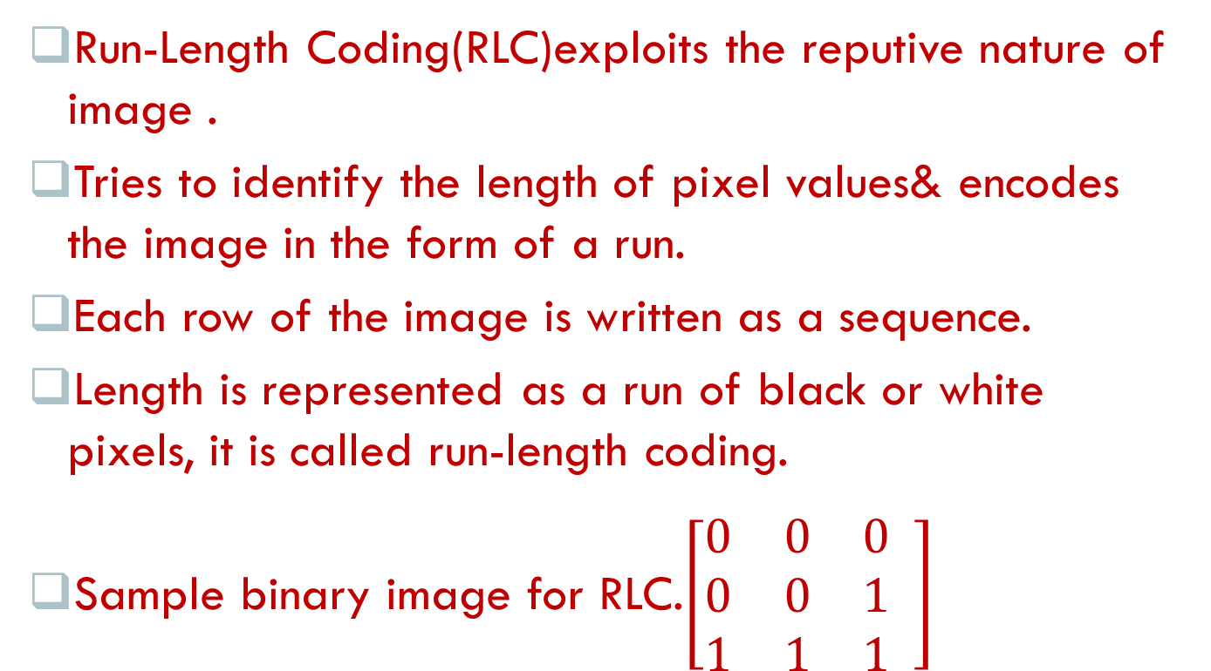
Run – Length Coding
Run-Length Coding(RLC)exploits the reputive nature of image .
Tries to identify the length of pixel values& encodes the image in the form of a run.
Each row of the image is written as a sequence.
Length is represented as a run of black or white pixels, it is called run-length coding.
Sample binary image for RLC.$\left[\begin{matrix}0 & 0 & 0 \\ 0 & 0 & 1 \\ 1 & 1 & 1\end{matrix} \right]$

Slide 64
Contd….
RLC is a CCITT(Consultative Committee of the International Telegraph & Telephone), now standard that is used to encode binary & grey-level images.
Scan image row by row & identify the run.
The output run-length vector specifies the pixel value & the length of the run.
Run vectors are as follows:
(0,5)
(0,3),(1,2)
(1,5)
(1,5)
(1,5)
Max. length is 5.Total vector is 6. Max no. of bit is 3.

Slide 65
Contd….
No. of bits per pixel is one, total no. of pixel is 6x(3+1)=24.
Total no. of bits of original image is 5x5=25.
Compression ratio is 25/24, that is 1.042:1.
Vertical scanning of image is: (0,2)(1,3)
(0,2)(1,3)
(0,2)(1,3)
(1,2)(1,3)
(0,1)(1,4)
(0,1)(1,4)
Total no. of vector = 10
Max. no. of bits=3
No. of bits per pixel=1
Therefore, 10x(3+1)=40.
Compression Ratio=25/40=0.625:1

Slide 66
Contd….
Scan line be changed to zigzag;
Vertical scanning yields:
(0,5)
(1,2)(0,3)
(1,5)
(1,5)
(1,5)

Slide 67
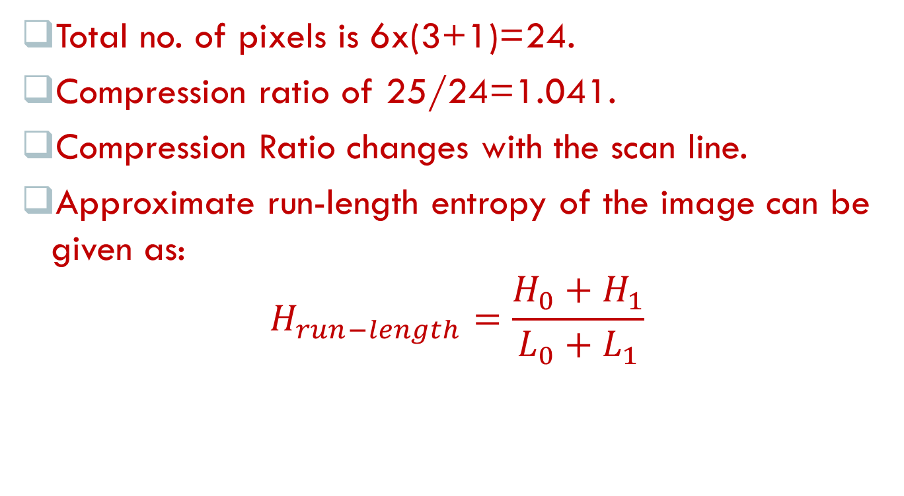
Contd….
Total no. of pixels is 6x(3+1)=24.
Compression ratio of 25/24=1.041.
Compression Ratio changes with the scan line.
Approximate run-length entropy of the image can be given as:
$$H_{run−length}=\frac{H_{0}+H_{1}}{L_{0}+L_{1}}$$

Slide 68
Huffman Coding
The canonical Huffman code is a variation of huffman code.
A tree is constructed using following rules called huffman code tree.
1.New created item is given priority & put at highest pointing stored list.
2.In combination process, the higher-up symbol is assigned code 0 & lower code down symbol is assigned 1.

Slide 69
Contd….
Rank | initial | Pass1 | Pass2 | Pass3
Highest | A=0.4 | A=0.4 | BDC=0.6 | ABDC=1.0
 | B0.3 | B=0.3 | A0.4
 | C=0.2 | DC=0.3
Lowest | D=0.1
Source | A | B | C | D
Code | 1 | 00 | 010 | 011

Slide 70
Huffman Decoder
Find the coded message. Start from root.
If read bit is 0 move to left, otherwise move to right.
Repeat the steps until leaf is reached, then generate the code & start again from the root
Repeat steps 1-3 till the end of message.

Slide 71
Truncated Huffman Code
It is similar to general huffman algorithm, but only most probable k item is coded.
Procedure is given below:
1.Most probable K symbol is coded with general Huffman algorithm.
2.Remaning symbol are coded with FLC(fixed length code).
3.Special symbol are now coded with Huffman code.

Slide 72
Shift Huffman Code
This is another variation in code.
Process is given below:
1.Arrange symbol in ascending order based on there probability.
2.Divide no. of symbols in equal size blocks.
3.All symbols in block are coded using Huffman algorithm.
4.Distinguish each block with special symbol. Code is special symbol.
5.Huffman code of block identification symbol is attached to blocks.

Slide 73
Shannon – Fano Coding
Difference in Huffman & Shannon is that the binary tree construction is top-down in the former.
Whole alphabet of symbol is present in root.
Node is split in two halves one corresponding to left & corresponding to right, based on the values of probabilities.
Process is repeated recursively & tree is formed. 0 is assigned to left & 1 is assigned to right.

Slide 74
Contd….
Steps of Shannon-Fano algorithm is as follows:
1.List the frequency table & sort the table on the basis of freq.
2.Divide table in two halves such that groups have more or less equal no. of frequencies.
3.Assign 0 to upper half & 1 to lower half.
4.Repeat the process recursively until each symbol becomes leaf of a tree.

Slide 75
Contd….
Example of a Shannon-Fano frequency code.
First division
Second division
Symbol | A | B | C | D | E
Frequency | 12 | 8 | 7 | 6 | 5
Symbol | A | B | C | D | E
Frequency | 12 | 8 | 7 | 6 | 5
Sum | (20) |  | (18)
Assign bit | 0 |  | 1
Symbol | A | B | C | D | E
Frequency | 12 | 8 | 7 | 6 | 5
Sum | 12 | 8 | 7 | 11
Code | 00 | 01 | 10 | 11

Slide 76
Contd….
Third division
Final codes
Symbol | A | B | C | D | E
Frequency |  |  |  | 6 | 5
Sum |  |  |  | 6 | 5
Code |  |  |  | 110 | 111
Symbol | A | B | C | D | E
Code | 00 | 01 | 10 | 110 | 111

Slide 77
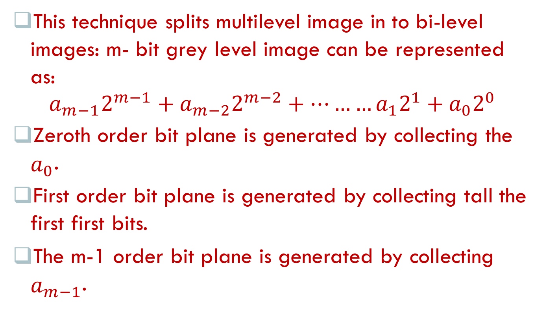
Bit-Plane Coding
This technique splits multilevel image in to bi-level images: m- bit grey level image can be represented as:
$$a_{m−1}2^{m−1}+a_{m−2}2^{m−2}+………a_{1}2^{1}+a_{0}2^{0}$$
Zeroth order bit plane is generated by collecting the $a_{0}$.
First order bit plane is generated by collecting tall the first first bits.
The m-1 order bit plane is generated by collecting $a_{m−1}$.

Slide 78
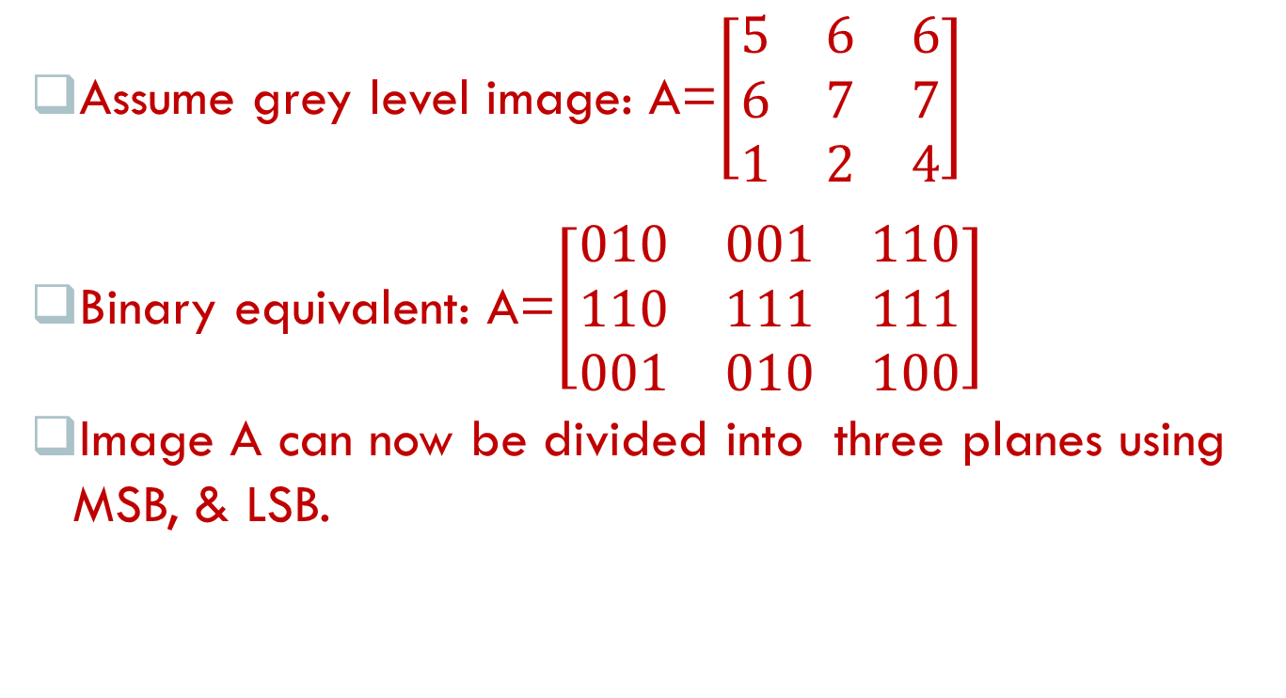
Contd….
Assume grey level image: A=$\left[\begin{matrix}5 & 6 & 6 \\ 6 & 7 & 7 \\ 1 & 2 & 4\end{matrix}\right]$
Binary equivalent: A=$\left[\begin{matrix}010 & 001 & 110 \\ 110 & 111 & 111 \\ 001 & 010 & 100\end{matrix}\right]$
Image A can now be divided into three planes using MSB, & LSB.

Slide 79
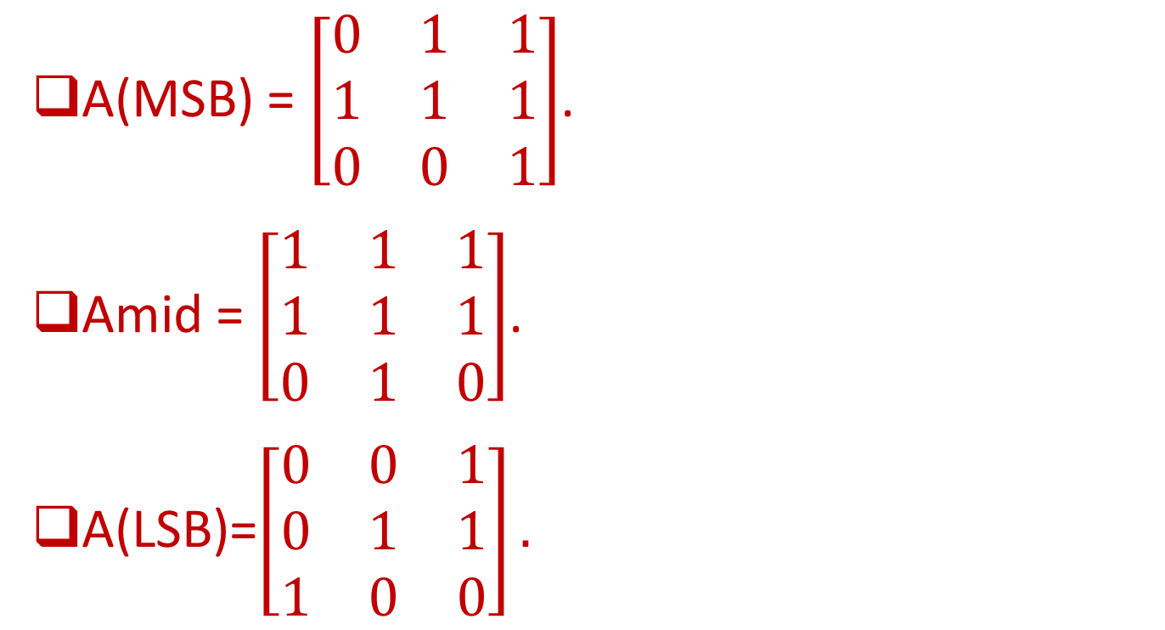
Contd….
A(MSB) = $\left[\begin{matrix}0 & 1 & 1 \\ 1 & 1 & 1 \\ 0 & 0 & 1\end{matrix}\right]$.
Amid = $\left[\begin{matrix}1 & 1 & 1 \\ 1 & 1 & 1 \\ 0 & 1 & 0\end{matrix}\right]$.
A(LSB)=$\left[\begin{matrix}0 & 0 & 1 \\ 0 & 1 & 1 \\ 1 & 0 & 0\end{matrix}\right].$

Slide 80
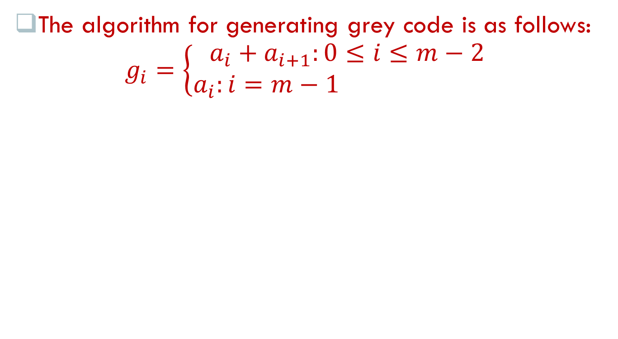
Contd….
The algorithm for generating grey code is as follows:
$$g_{i}=\left\{\begin{aligned}a_{i}+a_{i+1}:0≤i≤m−2 \\ a_{i}:i=m−1 \end{aligned}\right.$$

Slide 81
Arithmetic Coding
It is another popular algorithm is widely used, like the Huffman.
Difference b/w them is shown below:
Arithmetic coding | Huffman coding
Complex technique for coding | Simple t1chnique
It is always optimum | It is optimal only if the probabilities of the symbol are negative powers of two.
Precision is big issue | Precision is not a big issue.
There is no slow reconstruction | There is slow reconstruction when the no. of symbol is very large & changing rapidly.

Slide 82
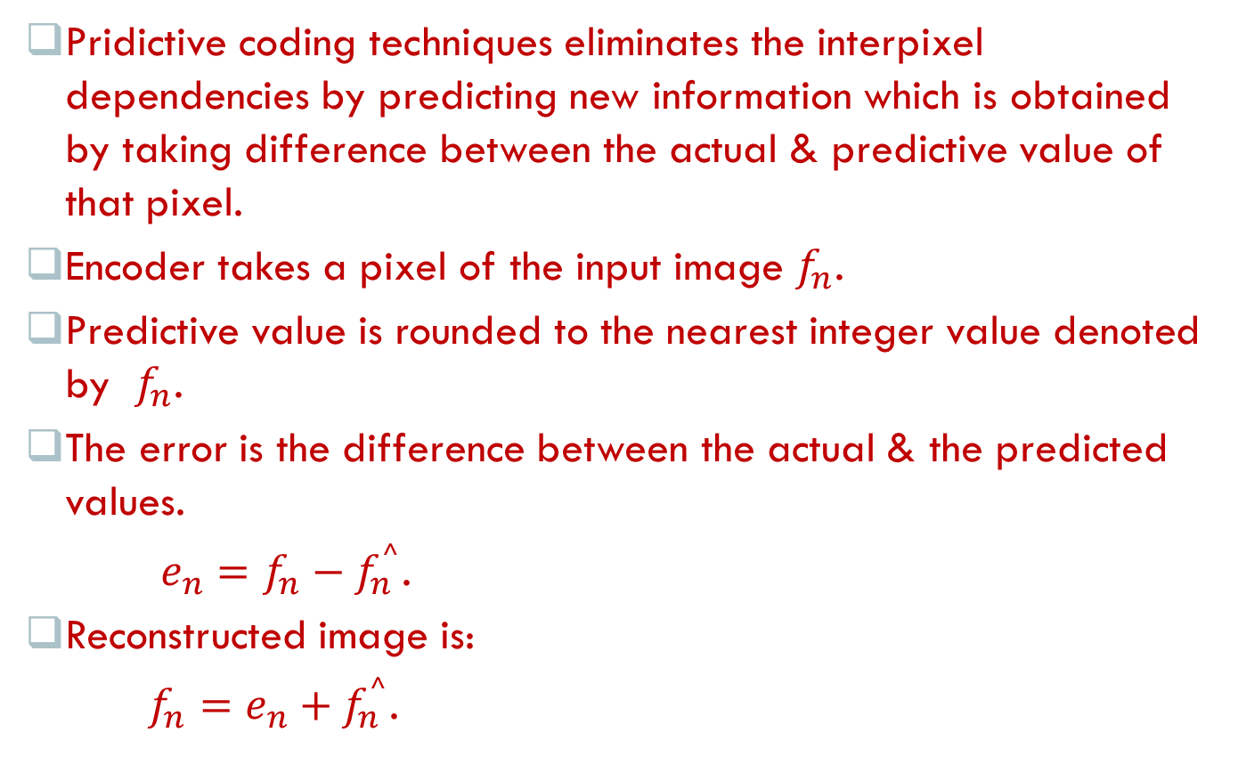
Lossless predictive coding
Pridictive coding techniques eliminates the interpixel dependencies by predicting new information which is obtained by taking difference between the actual & predictive value of that pixel.
Encoder takes a pixel of the input image $f_{n}$.
Predictive value is rounded to the nearest integer value denoted by $f_{n}$.
The error is the difference between the actual & the predicted values.
$e_{n}=f_{n}−f_{n}^{⌃}$.
Reconstructed image is:
$f_{n}=e_{n}+f_{n}^{⌃}$.

Slide 83
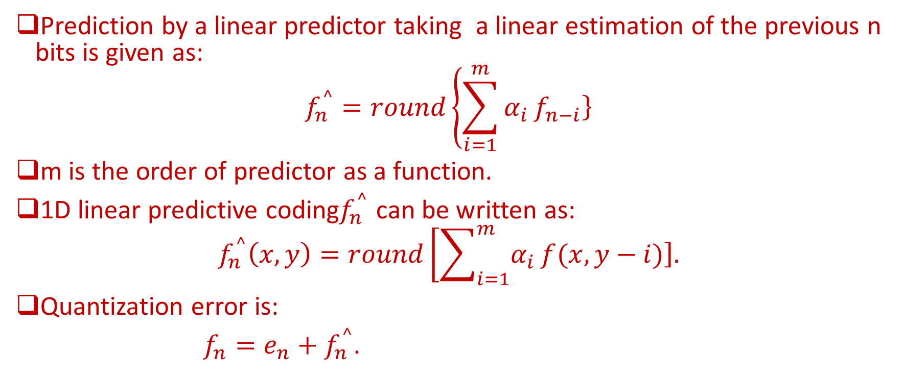
Contd….
Prediction by a linear predictor taking a linear estimation of the previous n bits is given as:
$$f_{n}^{⌃}=round\left\{\sum_{i=1}^{m}{α_{i}}\left.f_{n−i}\right\}\right.$$
m is the order of predictor as a function.
1D linear predictive coding$f_{n}^{⌃}$ can be written as:
$$f_{n}^{⌃}\left(x,y\right)=round\left[\sum_{i=1}^{m}{α_{i}}\left.f(x,y−i)\right].\right.$$
Quantization error is:
$f_{n}=e_{n}+f_{n}^{⌃}$.

Slide 84
Lossy Compression Algorithm
Lossy compression algorithms, unlike lossless compression algorithms, incur loss of information. This is called distortion.
Compression ratio of these algorithms is very large. Some popular lossy compression algorithms are as follows:
1.Lossy Predictive Coding.
2.Vector Quantization.
3.Block Transform Coding.

Slide 85
Lossy Predictive Coding
Predictive coding can also be implemented as a lossy compression scheme.
Instead of taking precautions, the highest value for 5 bits, that is, 31 can be used.
This drastically reduces the number of bits, & increases loss of information too.
Value | Lossy Predictive Coding
23 | 23
64 | 64-23=41(crosses the threshold of 5 bits). However, stores only 31supported by 5 bits+ one sign bit = 6 bits.
39 | 39-64=25
47 | 47-39=8
55 | 55-47=8
63 | 63-55=8

Slide 86
Contd….
Predictive coding with overloading is shown in table below:
Number of bits used to transmit is same as the original scheme, but the value 31 is transmitted instead of 41.
Values | Lossy predictive coding
23 | 23
64 | 64-23=41(crosses the threshold of 5 bits). However, stores only 31 supported by 5 bits=one sign bits.
39 | 39-64=-25
47 | 47-39=8
55 | 55-47=8
63 | 63-55=8

Slide 87
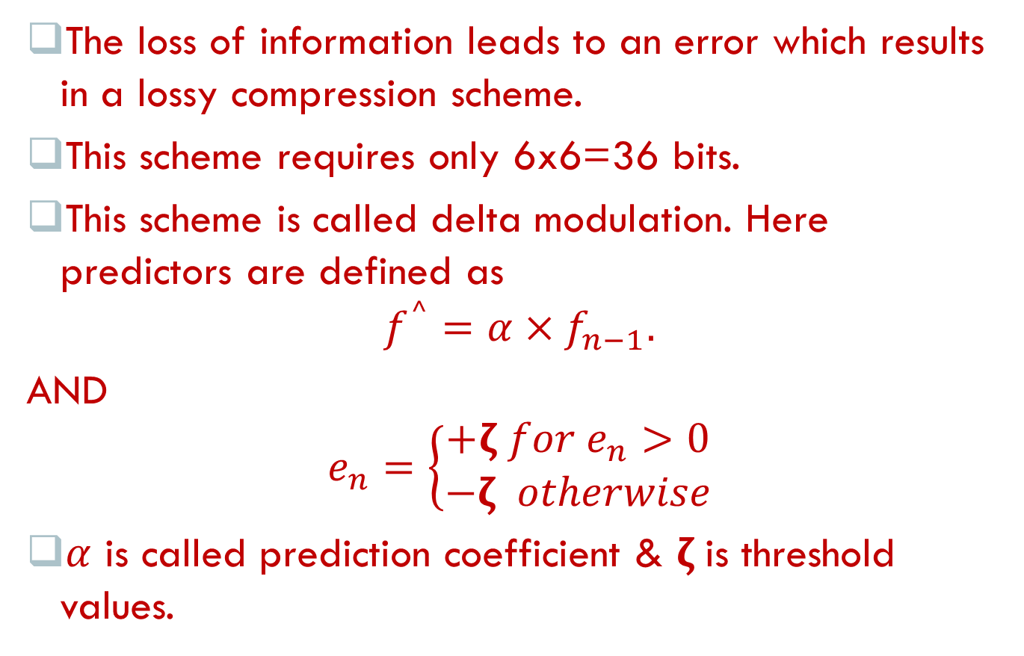
Contd….
The loss of information leads to an error which results in a lossy compression scheme.
This scheme requires only 6x6=36 bits.
This scheme is called delta modulation. Here predictors are defined as
$$f_{}^{⌃}=α×f_{n−1}.$$
AND
$$e_{n}=\left\{\begin{aligned}+ζ for e_{n}>0 \\ −ζ otherwise\end{aligned}\right.$$
$α$ is called prediction coefficient & $ζ$is threshold values.

Slide 88
Vector Quantization
Vector quantization (VQ) is a technique similar to scalar quantization.
Idea of (VQ) is to identify the frequently occurring blocks in an image & to represent them as representative vectors.
Set of all representative vectors is called the code book.
Structure of (VQ) is shown below:
Mapping Function Q
Training Set
Coding Vectors
Code Book

Slide 89
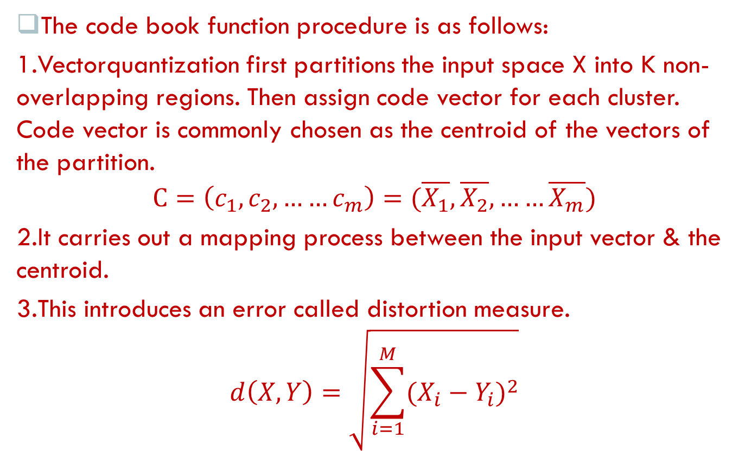
Contd….
The code book function procedure is as follows:
1.Vectorquantization first partitions the input space X into K non-overlapping regions. Then assign code vector for each cluster. Code vector is commonly chosen as the centroid of the vectors of the partition.
$$C=\left(c_{1},c_{2},……c_{m}\right)=(\overline{X_{1}},\overline{X_{2}},……\overline{X_{m}})$$
2.It carries out a mapping process between the input vector & the centroid.
3.This introduces an error called distortion measure.
$$d\left(X,Y\right)=\sqrt{\sum_{i=1}^{M}{{(X_{i}−Y_{i})}^{2}}}$$

Slide 90
Contd….
X & Y are two dimensional vectors.
4.Codebook of vector quantization consists of all the code words. The image is then divided into fixed size blocks.

Slide 91
Block Transform Coding
Block transform coding is another popular lossy compression scheme.
Transform coding model.
I/P image
Construct nxn sub-images
Apply transform
Quantizer
Symbol encoder
Transmission channel
Symbol decoder
Apply inverse transform
Merge the sub-blocks

Slide 92
Sub – image selection
Aim of this image is to reduce the correlation between adjacent pixels to an acceptable levels.
Most important stages where the image is divided into a set of sub-images.
The NxN image is decomposed of a set of images of size nxn for operational convenience.
Value of n is a power of two.
This is to ensure that the correlation among the pixels is minimum.
This step is necessary to reduce the transform coding error & computational complexity.
Sub-images would be of size 8x8 or 16x16.

Slide 93
Transform selection
Idea of transform coding is to use mathematical transforms for data compression.
Transformation such as Discrete Fourier Transform(DFT), Discrete Cosine Transform(DCT), & Wavelet Transform can be used.
DCT offers better information packing capacity.
KL transform is also effective, but the disadvantage is that they are data-dependent.
The digital cosine transform is preferred because it is faster & hence can pack more information.

Slide 94
Bit Allocation
It is necessary to allocate bits so that compressed image will have minimum distortions.
Bit allocation should be done based on the importance of data .
Idea of bit allocation is to reduce the distortion by allocation of bits to the classes of data. Few steps are involved in that are as follows:
1.Assign predefined bits to all classes of data in the image.
2.Reduce the number of bits by one & calculate the distortion.
3.Identify the data is associated with the machine distortion & reduce one bit from its quota.

Slide 95
Contd….
4. Find the distortion rate again.
5.Compare with the target & if necessary repeat steps 1-4to get optimal rate.

Slide 96
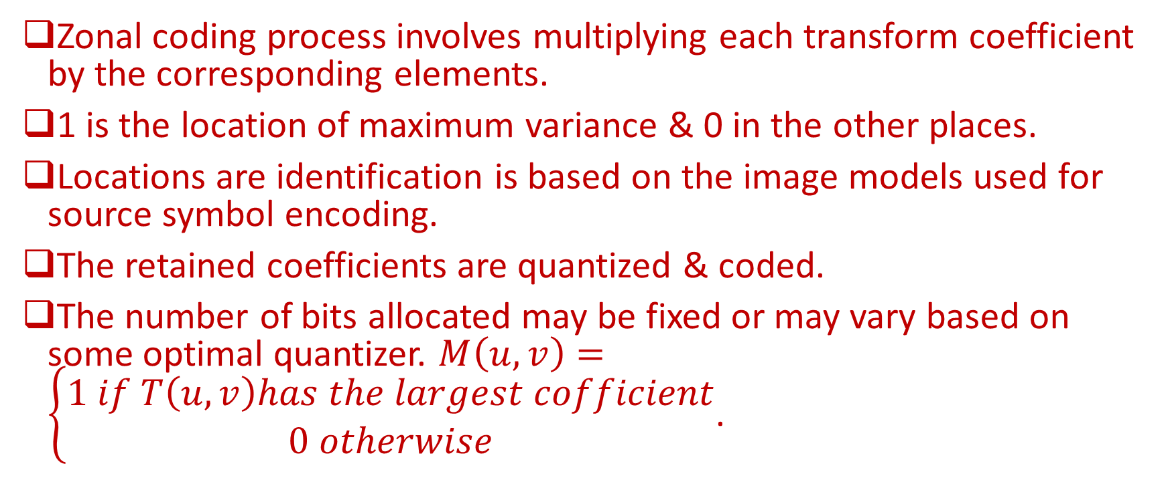
Zonal coding
Zonal coding process involves multiplying each transform coefficient by the corresponding elements.
1 is the location of maximum variance & 0 in the other places.
Locations are identification is based on the image models used for source symbol encoding.
The retained coefficients are quantized & coded.
The number of bits allocated may be fixed or may vary based on some optimal quantizer. $M\left(u,v\right)=\left\{\begin{aligned}1 if T\left(u,v\right)has the largest cofficient \\ 0 otherwise\end{aligned}\right.$.

Slide 97
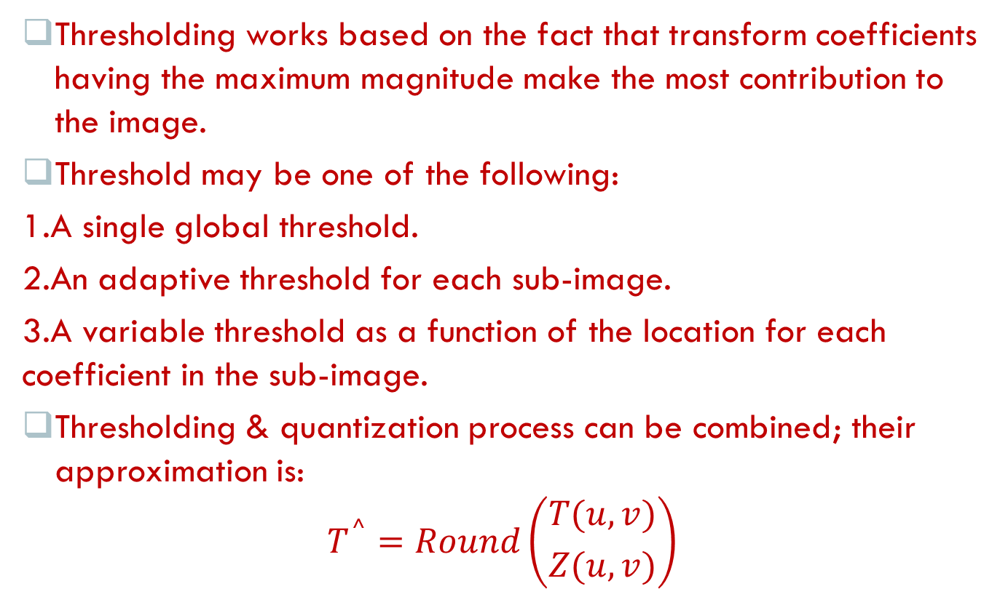
Threshold mask
Thresholding works based on the fact that transform coefficients having the maximum magnitude make the most contribution to the image.
Threshold may be one of the following:
1.A single global threshold.
2.An adaptive threshold for each sub-image.
3.A variable threshold as a function of the location for each coefficient in the sub-image.
Thresholding & quantization process can be combined; their approximation is:
$$T^{⌃}=Round\left({T(u,v) \atop Z(u,v)}\right)$$

Slide 98
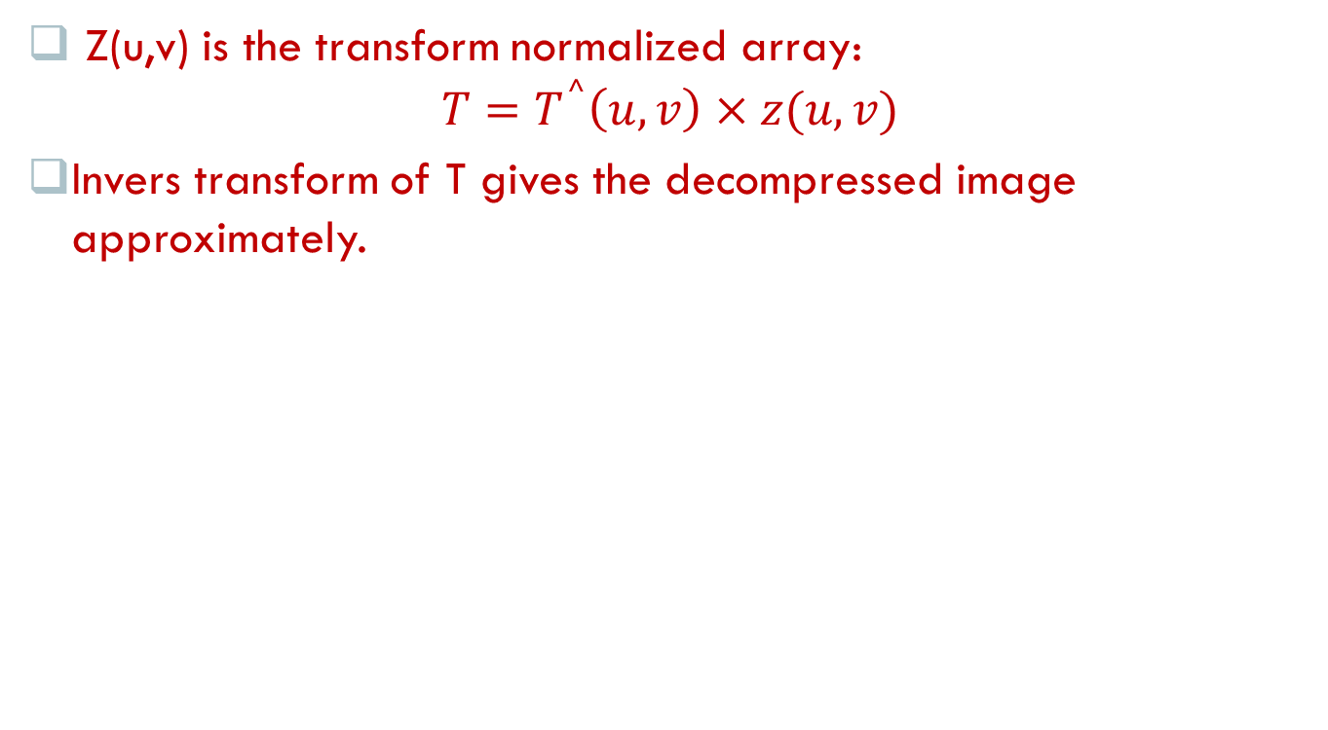
Contd….
Z(u,v) is the transform normalized array:
$$T=T^{⌃}\left(u,v\right)×z(u,v)$$
Invers transform of T gives the decompressed image approximately.

Slide 99
Penutup
Ada Pertanyaan?
Terima Kasih

